Slide 1
DEPRESSION HANDLING SKILL FOR AMAZON ALEXA
Team
Pavan Gadagi
Shefali Gaonker
Shreya Gaunekar
Guide
Mrs. Devaki Shinkre

Slide 2
CONTENTS
Introduction
Brief summary of Design phase
Implementation
Further work to be done
Bibliography

Slide 3
Introduction
Depression (major depressive disorder) is a common and serious medical illness that negatively affects how you feel, the way you think and how you act.
The death of a loved one, loss of a job or the ending of a relationship is difficult experiences for a person to endure.
The aim is to develop a depression handling skill for Amazon Alexa.
When the skill will be enabled, the Alexa will give most suitable responses for particular statement made by the user.

Slide 4
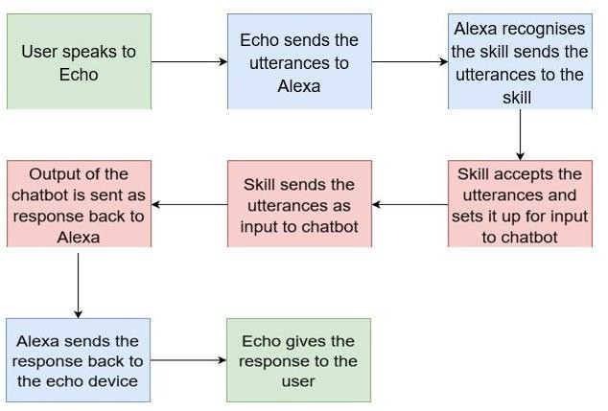
BRIEF SUMMARY OF DESIGN PHASE

Slide 5
During the experimentation with the chat bot , we realized that the chat bot cannot be implemented since Amazon Alexa had to be given what the user will speak as the input.
Another reason is that it cannot return whatever and however the user dictates.
So we traced back and came up with another solution where we explored different scenarios of depression and try to handle each of these separately.
To do this we had to create a tree where in, all the various scenarios were mapped together to make a general outline.

Slide 6
Depression may have various scenarios and each of them may have different symptoms and treatments.
Focus is on depression caused by relationship issues.
Problems in relationships can trigger confusion, emotional upset and questions regarding the future of the relationship. In some cases, these problems can contribute to the development of depression or of a depressive episode.
A tree structure is created highlighting both pre-marriage and post-marriage issues.
As of now only post-marriage issues are taken into consideration.

Slide 7
implementation

Slide 8
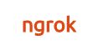
Implementation
Ngrok - Creates Tunnel from localhost to the internet.
ngrok http 5000
Sample utterances
Intent Schema

Slide 10
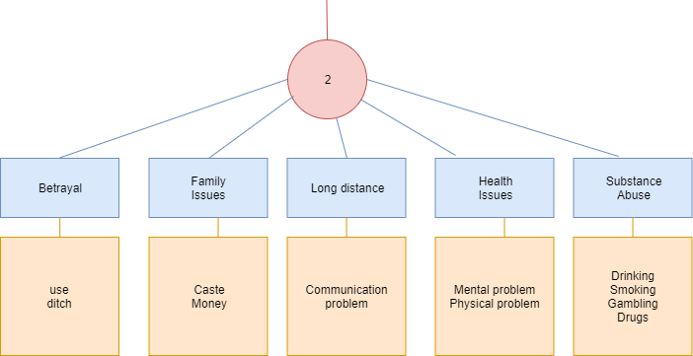

Slide 11
Further work to be done
Adding Pre-marriage issues and their subsequent responses in the skill.
Exploring other depression scenarios.
Testing the skill with multiple user inputs (experiences will vary from user to user).

Slide 12
References:
https://www.amazon.in
https://developer.amazon.com/public/solutions/alexa/alexa-skills-kit/getting-started-guide
https://developer.amazon.com/public/solutions/alexa/alexa-skills-kit /overviews/understanding-custom-skills
https://www.amazon.com/b?node=13727921011

Slide 13
Thank
You

